Slide 1
A Brief Tour of Data Engineering
Eric Flamm, Flamm Consulting
East Cobb/Sandy Springs Meetup
January 2, 2020

Slide 2
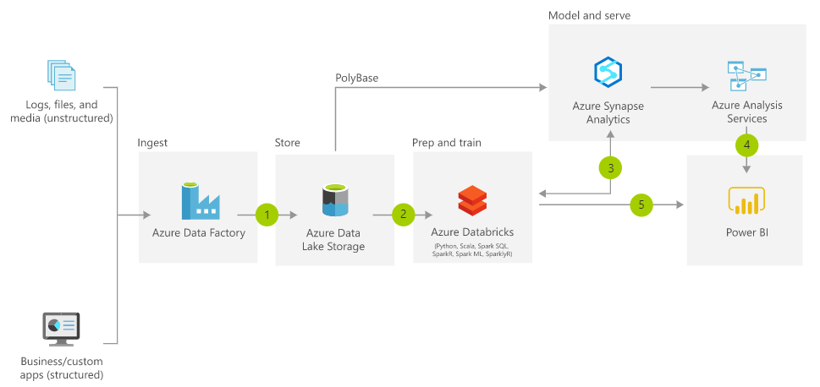
Modern Data Architecture

Slide 3
Data Engineer Roles
Identify Data Sources Relevant to the Business
Structured
Unstructured
Automate loading data in raw form to storage
Transform stored data into actionable intelligence
Apply business rules and statistical transformations
Enable business user access to data
Visual Exploration/Dashboards
Traditional reports and formatted documents (e.g., invoices)

Slide 4
To learn more
Eric Flamm, Flamm Consulting
eric@flammconsulting.com
https://www.linkedin.com/in/ericmflamm/
www.flammconsulting.com
(678) 524-4256

